Slide 1
A More Perfect Union
Different, maybe better, ways of counting votes

Slide 2
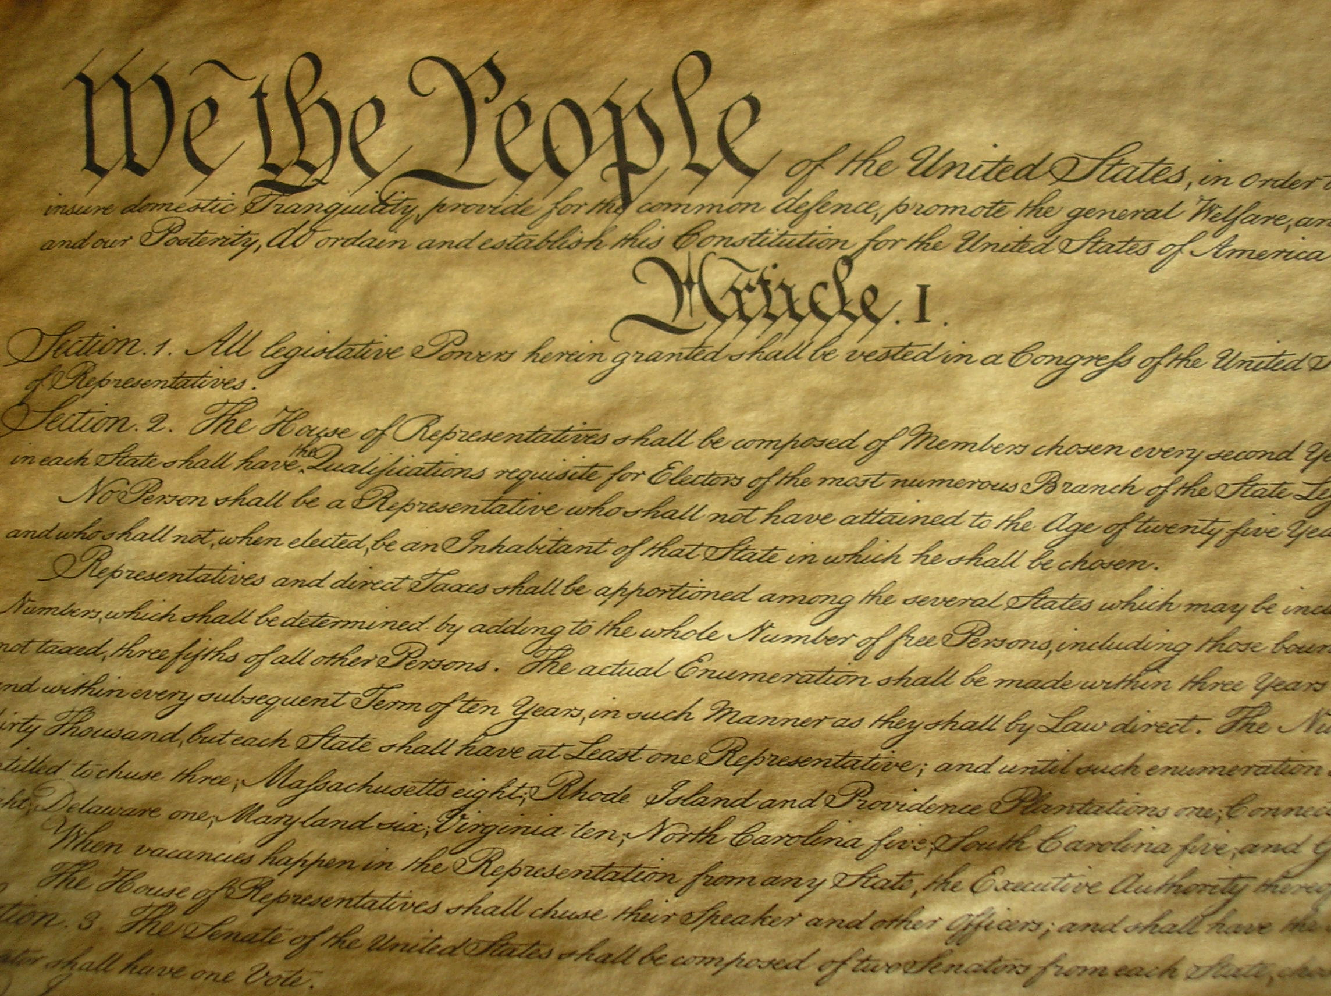
We the People…
Notes:
We the People of the United States, in Order to form a more perfect Union, establish Justice, insure domestic Tranquility, provide for the common defense, promote the general Welfare, and secure the Blessings of Liberty to ourselves and our Posterity, do ordain and establish this Constitution for the United States of America.”
----- Meeting Notes (11/15/16 09:22) -----
What do you think of when you think of the constitution?
For every thing you mentioned, let's take a moment to realize that in a Democracy, we as citizens are empowered to make that thing better, using the best proven thinking and technology.
One of the most important things, of course, is Voting.
----- Meeting Notes (11/15/16 09:24) -----
This talk is about different ways to count votes.

Slide 3
Introduction
Lots of things to vote for
Lots of ways to count the votes

Slide 4
Introduction
Not about the Electoral College
I have a hard time explaining why Hillary received at least 600,000 more votes than Donald Trump, but still is not President.
It has something to do with rural-urban population density.
But it happened the last two times the party of the president changed for a first term Presidential election.

Slide 5
Anyhow

Slide 6
Things to vote for: People
Single seat
President
Senator
Governor
Mayor
Member of House of Representatives
Leader of a club
Multiple seat
Board of supervisors
School Board
Homeowner’s Association
City Council
Student Council

Slide 7
Things to vote for: Things
Oscars: Movies
Grammys: Music
Tonys: Live productions (plays, musicals)
Newbery and Caldecott Medals: Books
Products
Amazon reviews
Yelp ratings
Tripadvisor ratings

Slide 8
Ways to Count the Votes
SO MANY WAYS!
At least 12 distinctly different systems, with numerous variations of each.
No commonly agreed upon names for all the systems.
Which one is best?
Remember, we’re trying to build a more perfect union.
There is no perfect system. Every one has its flaws

Slide 9
Three Classes of Voting Systems
Proportional Representation Systems
Multi-member bodies
Mixed Member Systems
Multi-member bodies
Plurality/Majoritarian systems
Single-seat

Slide 10
Focus on Plurality/Majoritarian
First Past The Post
What we have now
We inherited it from the British. It’s used in Britain and its former colonies (USA, India, Canada)
Two-round systems
Like first past the post, but if no candidate has > 50% of the votes, a second round is triggered, with only the top two vote getters as candidates

Slide 11
Focus on Plurality/Majoritarian
Instant Runoff
Rank your candidates in decreasing order of desirability
Process of elimination until one candidate has > 50%
Score Voting
Score each candidate on a scale
1 – 10
0 – 5 ★’s
Approval voting: each candidate gets zero or one vote

Slide 12

How about a fun video?

Slide 13

And one more!

Slide 14
Good News!
RCVMaine Question 5 Passed!
The next governer’s race in Maine will use Ranked Choice Voting

Slide 15
Now it’s your turn!
First Past the Post style
Ranked Choice style

Slide 16
Summary
First Past The Post
Vulnerable to “spoiler” problem
Instant Runoff Voting
Vulnerable to strategic voting in certain cases.
People still structuring their votes not based on who they think is best, but who they think will win.

